Slide 1
Analyzing NFL Player Performance Metrics and Game Outcomes
Benjamin Bartek
DSC 680
February 2, 2025

Slide 2
Business Problem
The NFL is a highly competitive league where team success depends on multiple performance factors. Understanding key metrics that influence game outcomes can optimize game strategies and improve decision-making.

Slide 3
Background & History
NFL analytics have evolved significantly, focusing on efficiency metrics like yards per play and turnover margins. This study aims to quantify the most impactful team metrics for predicting game success.

Slide 4
Data Set
Mendoza Chavez, R. (2023). NFL 2023 Season Dataset [Data set]. Kaggle. https://www.kaggle.com/datasets/ruendymendozachavez/nfl-2023-season-dataset
Metrics include points per game, yards per play, turnover margins, and rushing statistics.

Slide 5
Methods
Descriptive statistics for team performance trends.
Correlation analysis to identify key metrics affecting wins.
Predictive modeling using Random Forest to classify game winners.
Regression analysis to predict total points scored in games.
K-Means clustering to categorize teams based on performance.

Slide 6
Analysis & Key Findings
Turnover margin and yards per play strongly predict team success.
Teams with higher offensive efficiency score more points.
Defensive metrics also play a crucial role in determining outcomes.
Clustering analysis identified performance-based team groupings.

Slide 7
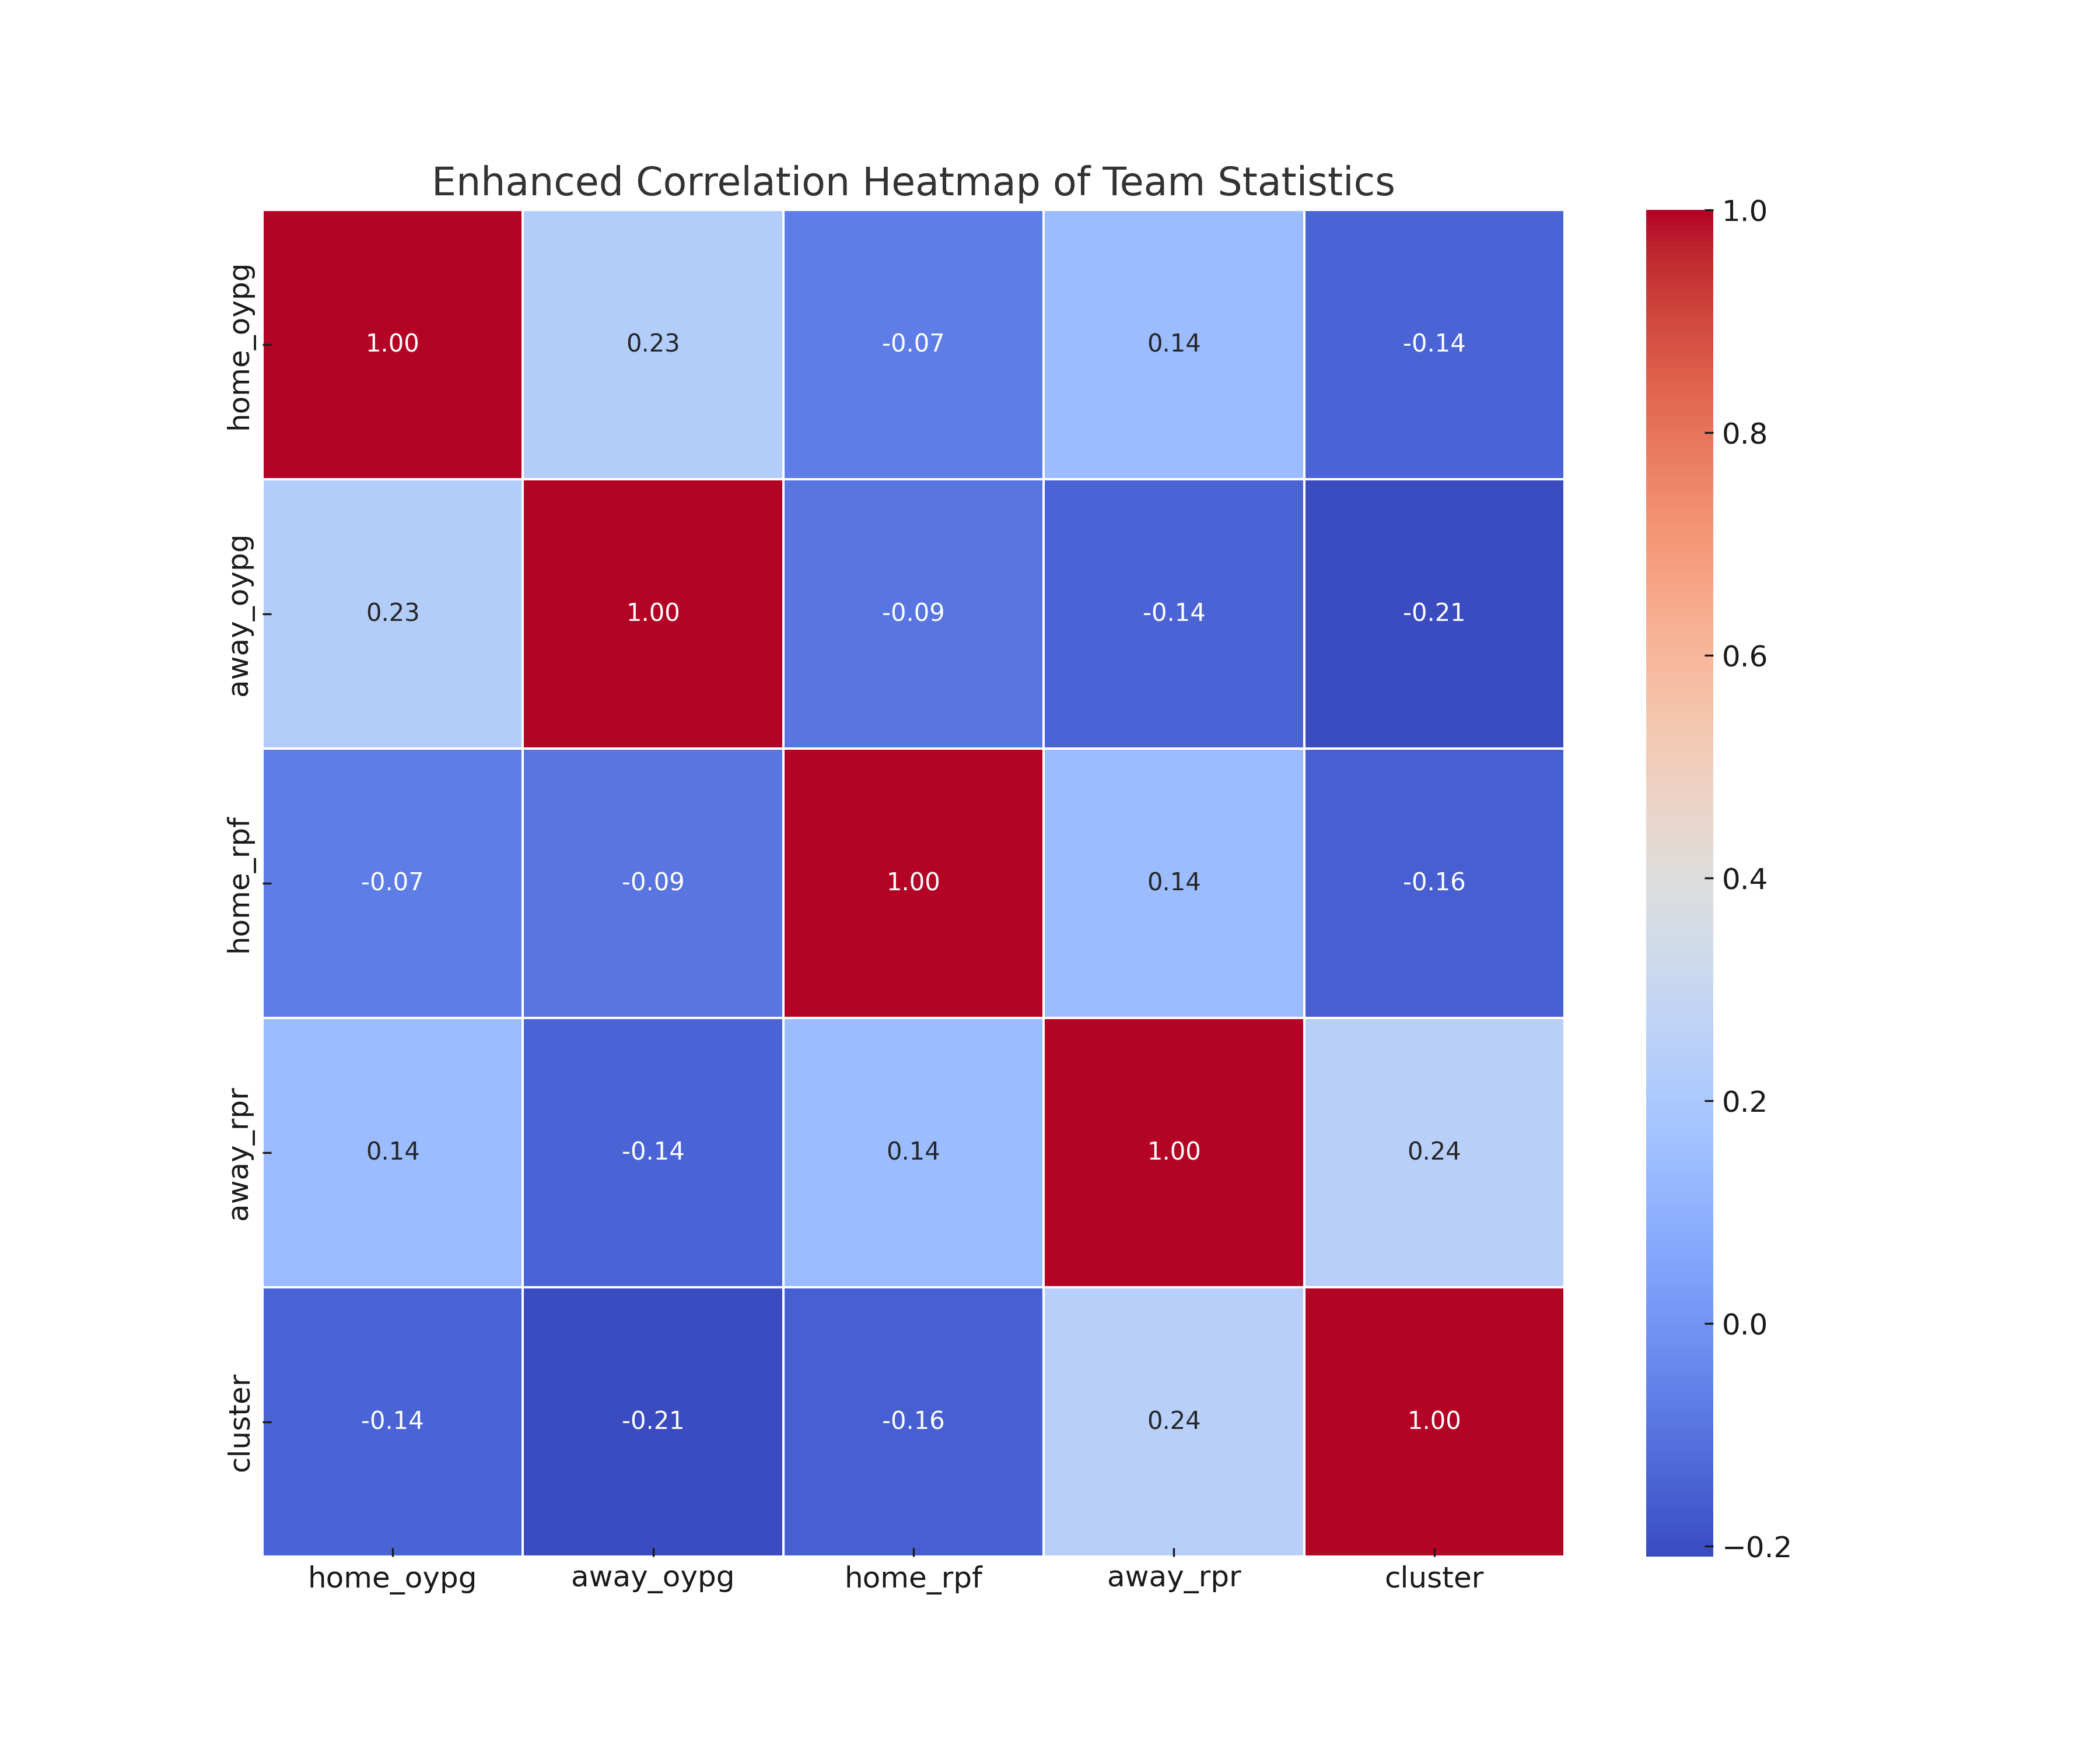
Figure 1: Enhanced Correlation Heatmap of Team Statistics

Slide 8
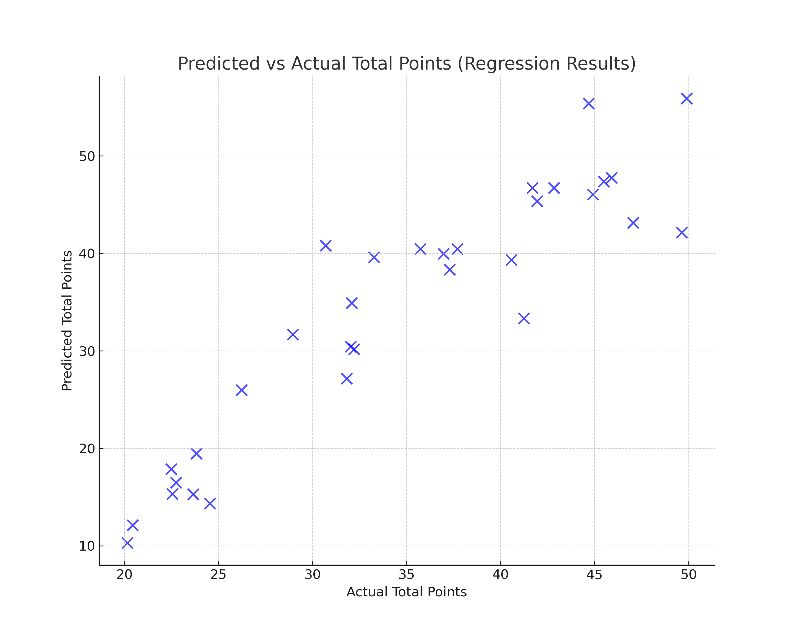
Figure 2: Predicted vs. Actual Total Points

Slide 9
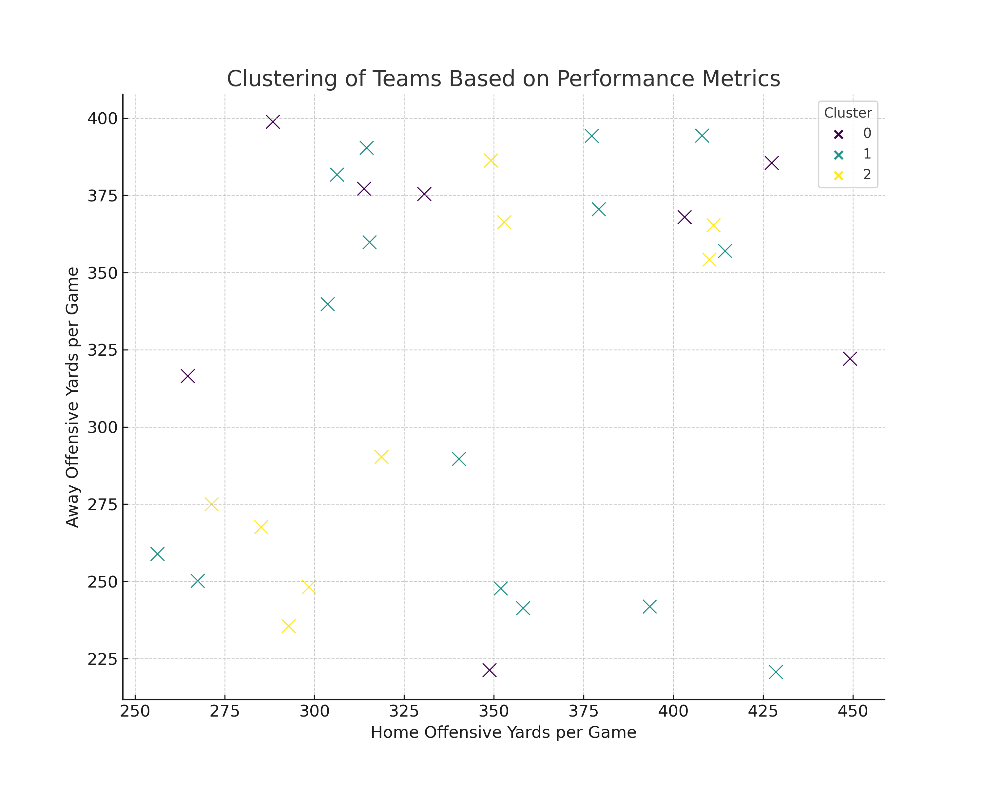
Figure 3: Clustering of teams Based on Performance Metrics

Slide 10
Recommendations
Teams should prioritize minimizing turnovers and improving offensive efficiency.
Data analytics should be incorporated into real-time game strategies.
Player acquisition should focus on players who contribute to key performance metrics.

Slide 11
Ethical Considerations
Ensure transparency in metric usage to avoid bias.
Protect player data privacy when integrating individual performance stats.
Avoid over-reliance on predictive analytics, balancing with human expertise.

Slide 12
Questions
1. What are the most important predictors of game outcomes? 2. How can teams operationalize these findings? 3. How accurate are the predictive models? 4. What were the limitations of the analysis? 5. How does this analysis account for player injuries? 6. Can these methods be applied mid-season for adjustments? 7. What external factors were excluded? 8. How does this analysis compare with traditional coaching strategies? 9. How scalable are these techniques to other sports? 10. What ethical concerns might arise with real-time usage?

Slide 13
References
Mendoza Chavez, R. (2023). NFL 2023 Season Dataset [Data set]. Kaggle. https://www.kaggle.com/datasets/ruendymendozachavez/nfl-2023-season-dataset

